Slide 1

Pleiotropy between independent mental health profiles in the UKB
Daniel Roelfs

Slide 2
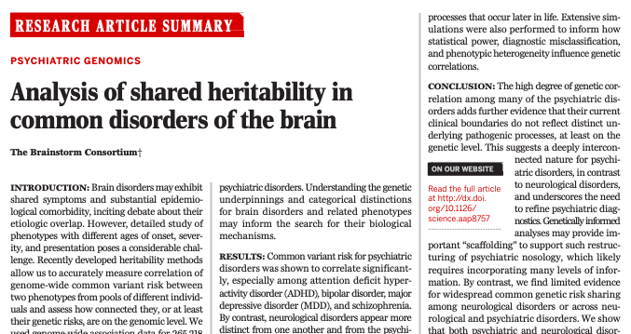
Background
Known genetic correlation and loci overlap between psychiatric disorders
Large clinical overlap between disorders
What about the overlap in symptom profiles?

Slide 3
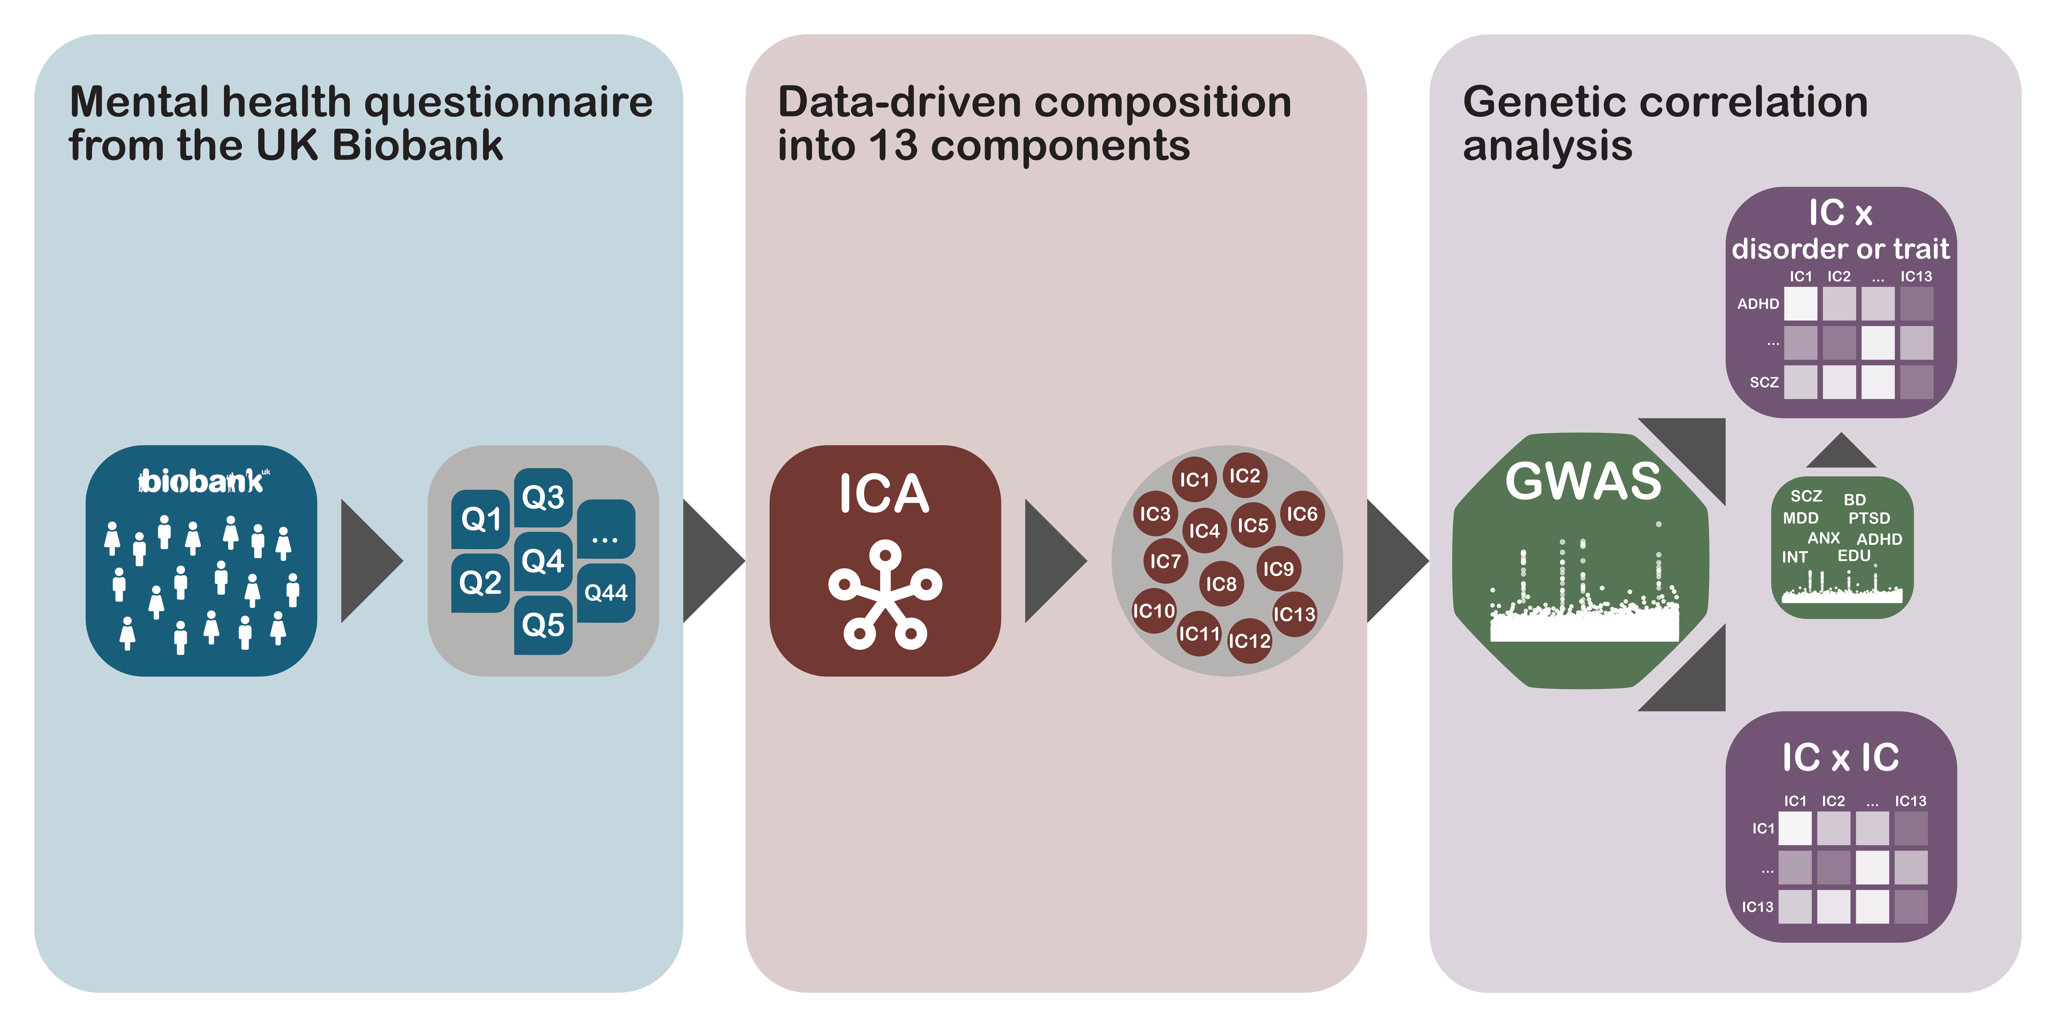
Our approach

Slide 4
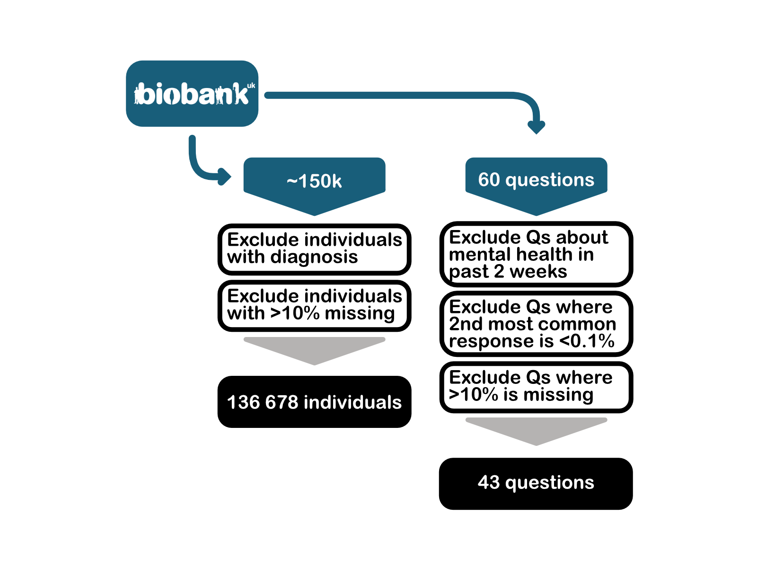

Slide 5
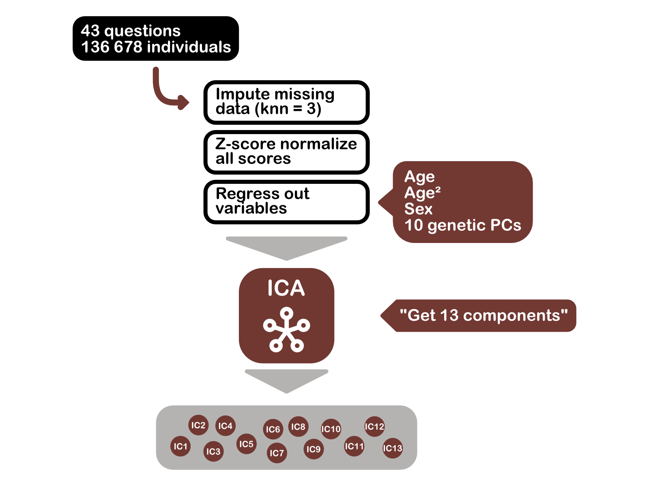

Slide 6
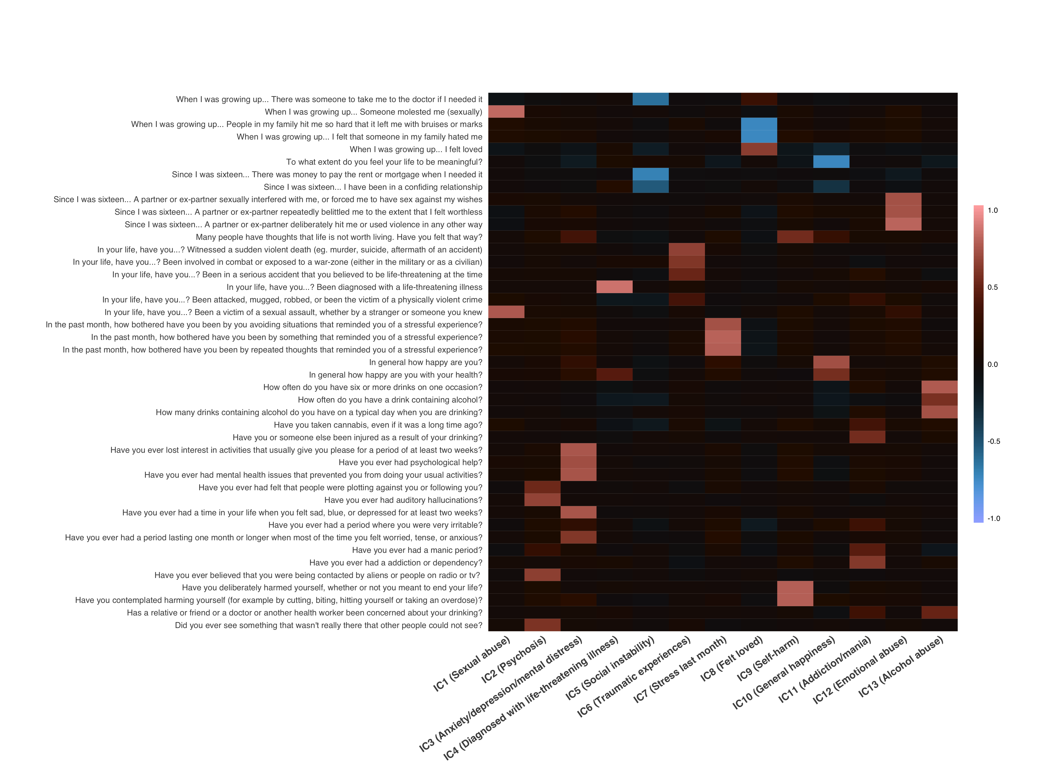

Slide 7
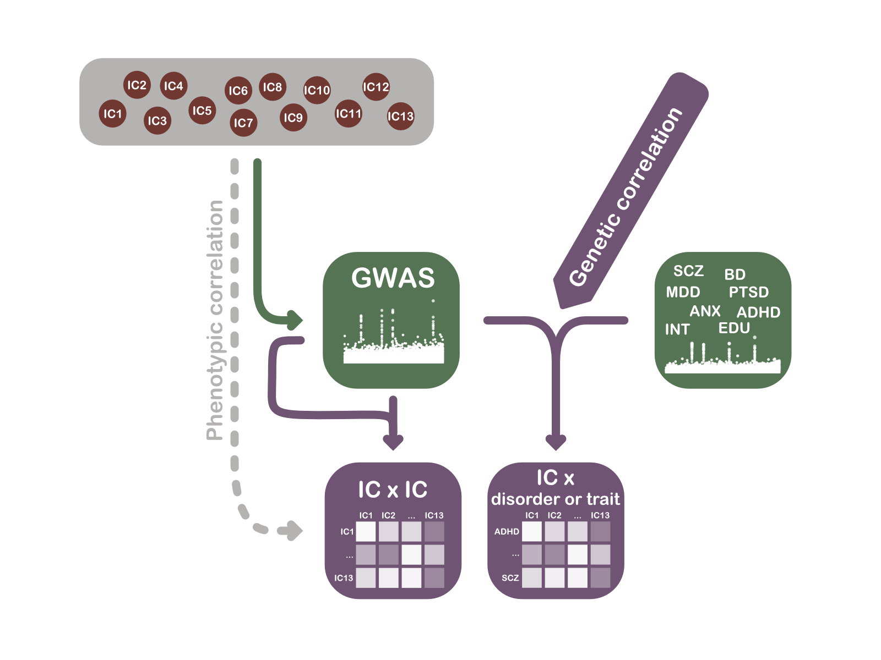

Slide 8
Results

Slide 12
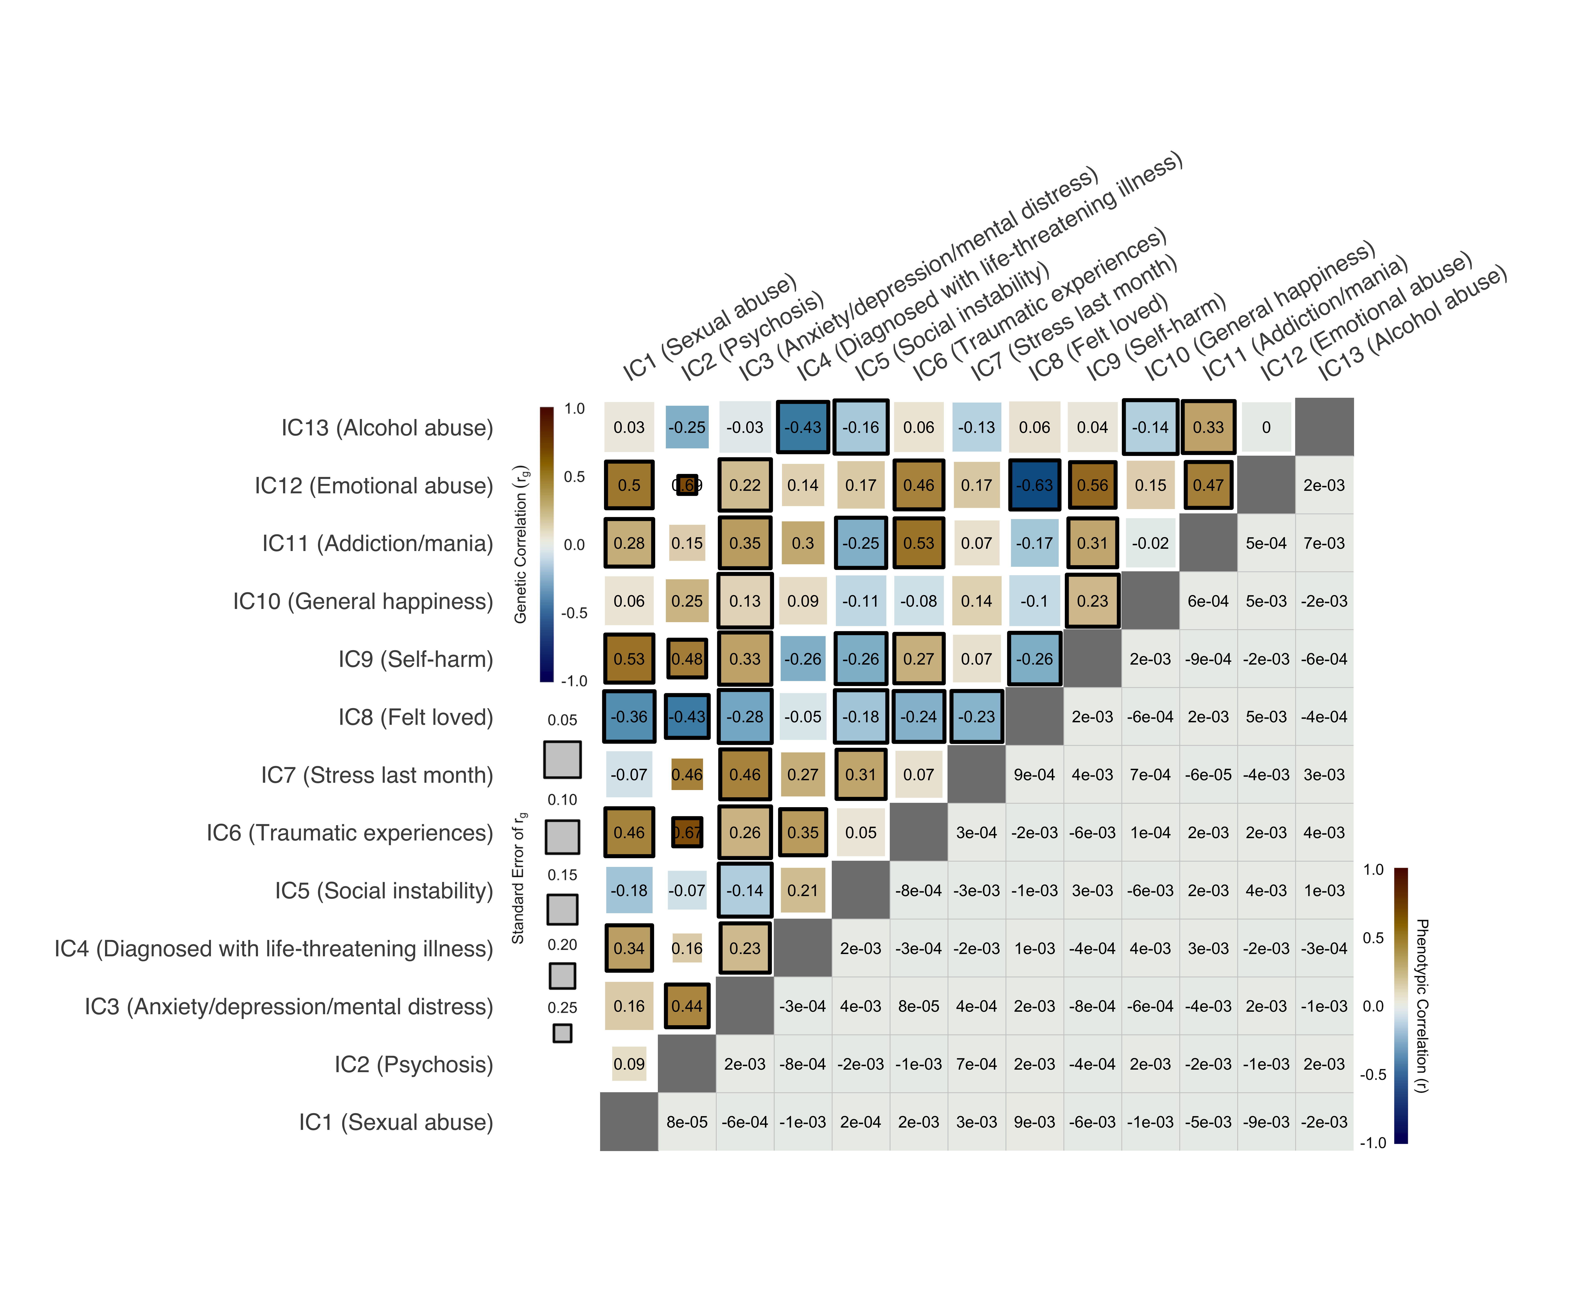

Slide 13
Conclusions
Variation in mental health in healthy individuals genetically correlate to psychiatric disorders and cognitive traits
Pleiotropy between disorders likely not due to overlapping symptoms
Classical case-control setup in certain situations not the most adequate approach
Big data 👍

Slide 14
Thanks!
Thanks to:
Tobias Kaufmann Dag Alnæs Oleksandr Frei Dennis van der Meer Olav Smeland Ole Andreassen Lars Westlye

Slide 16
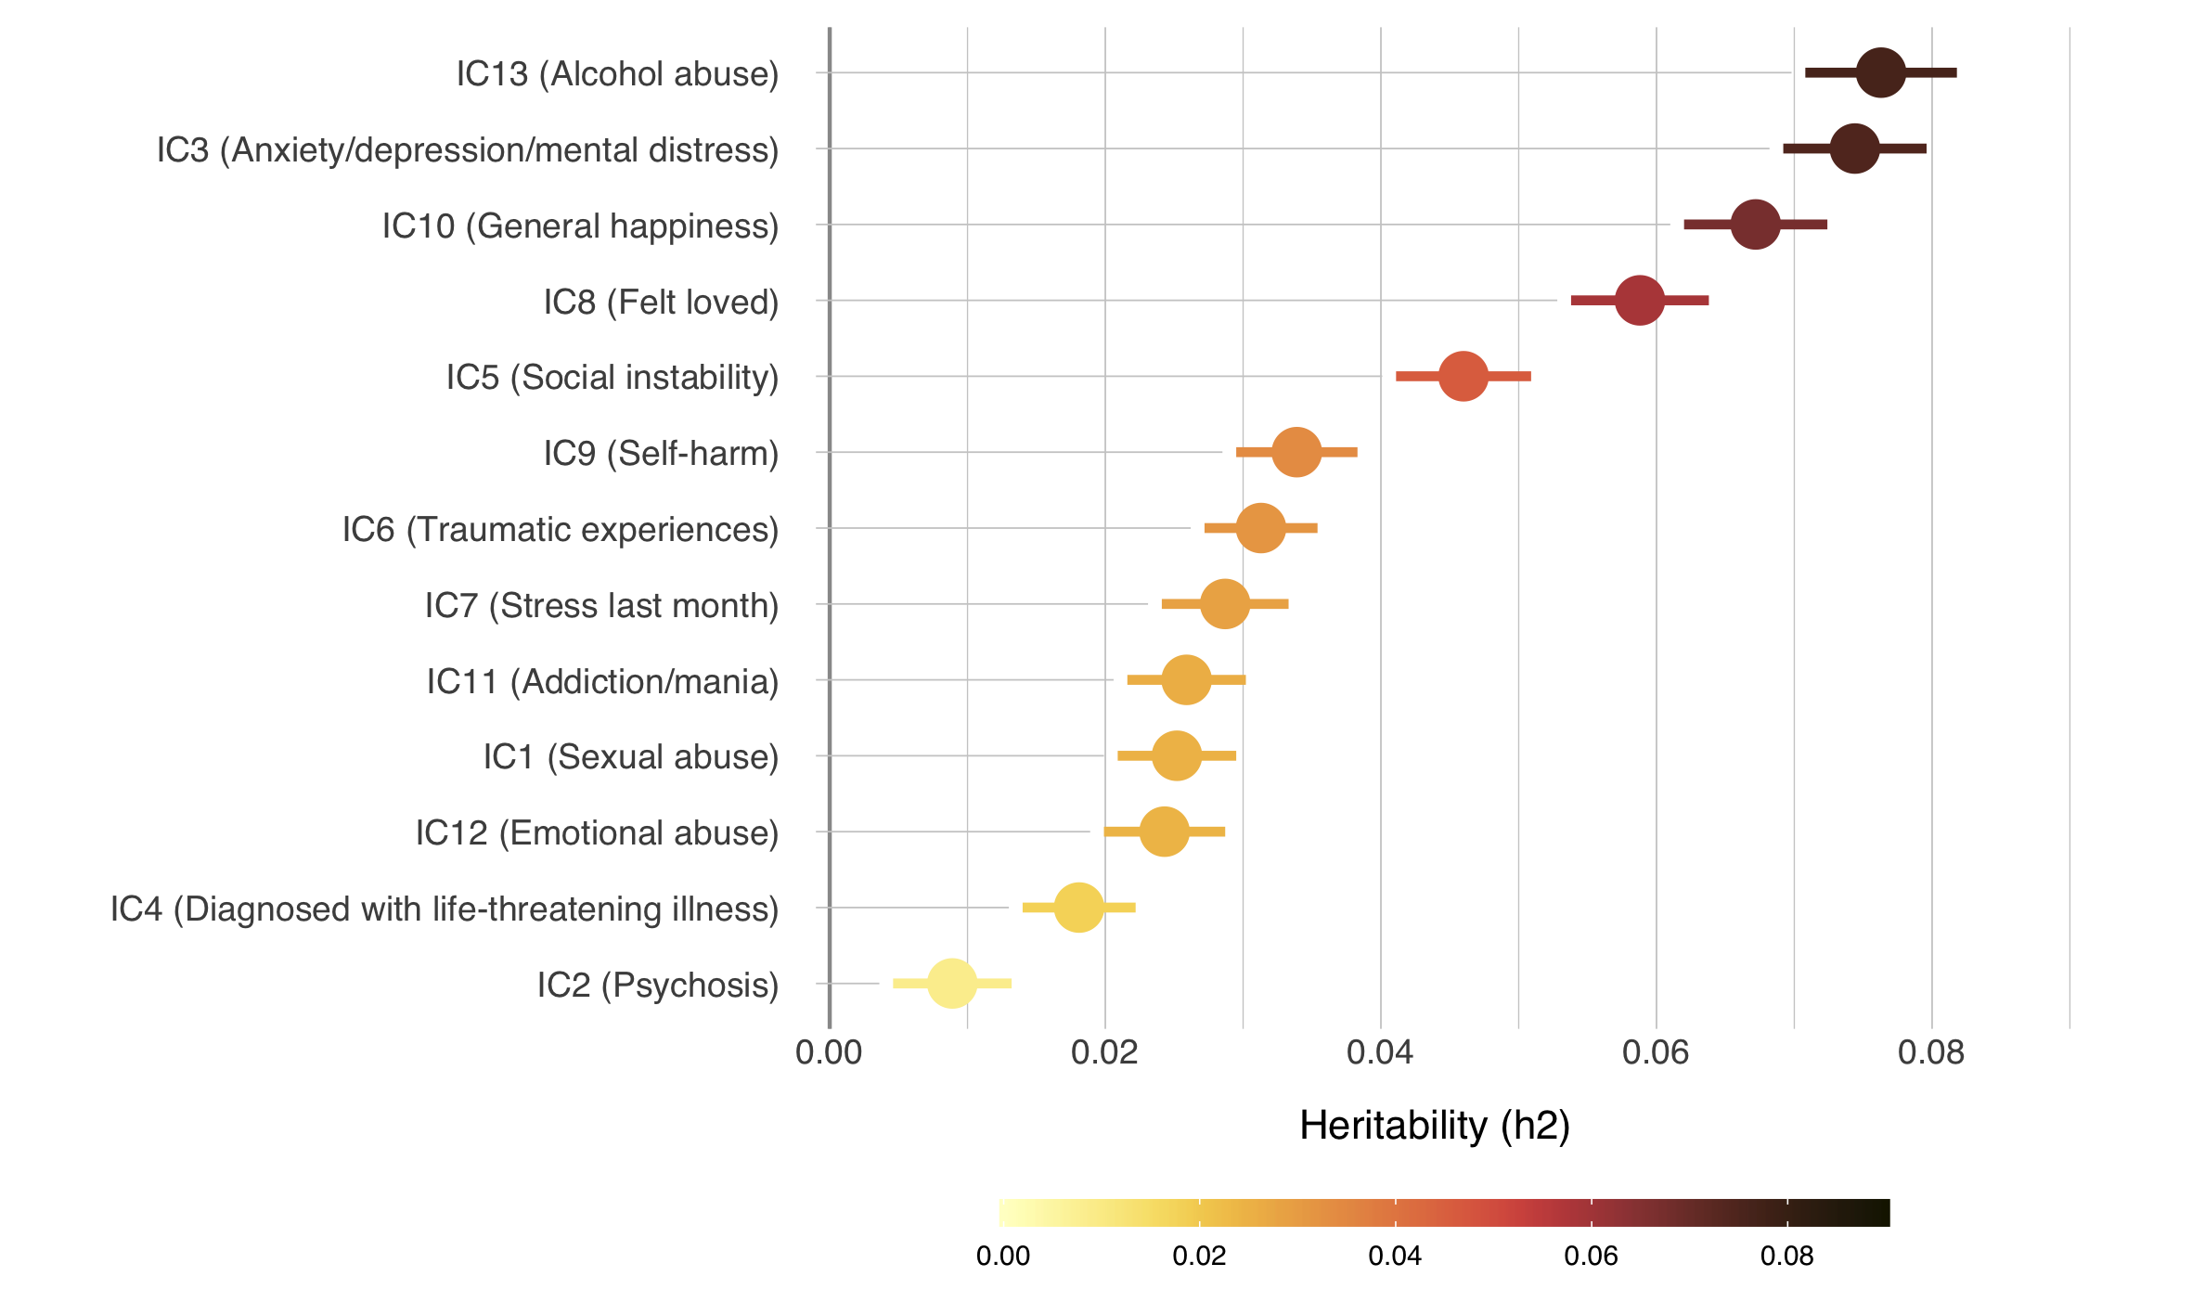

Slide 18
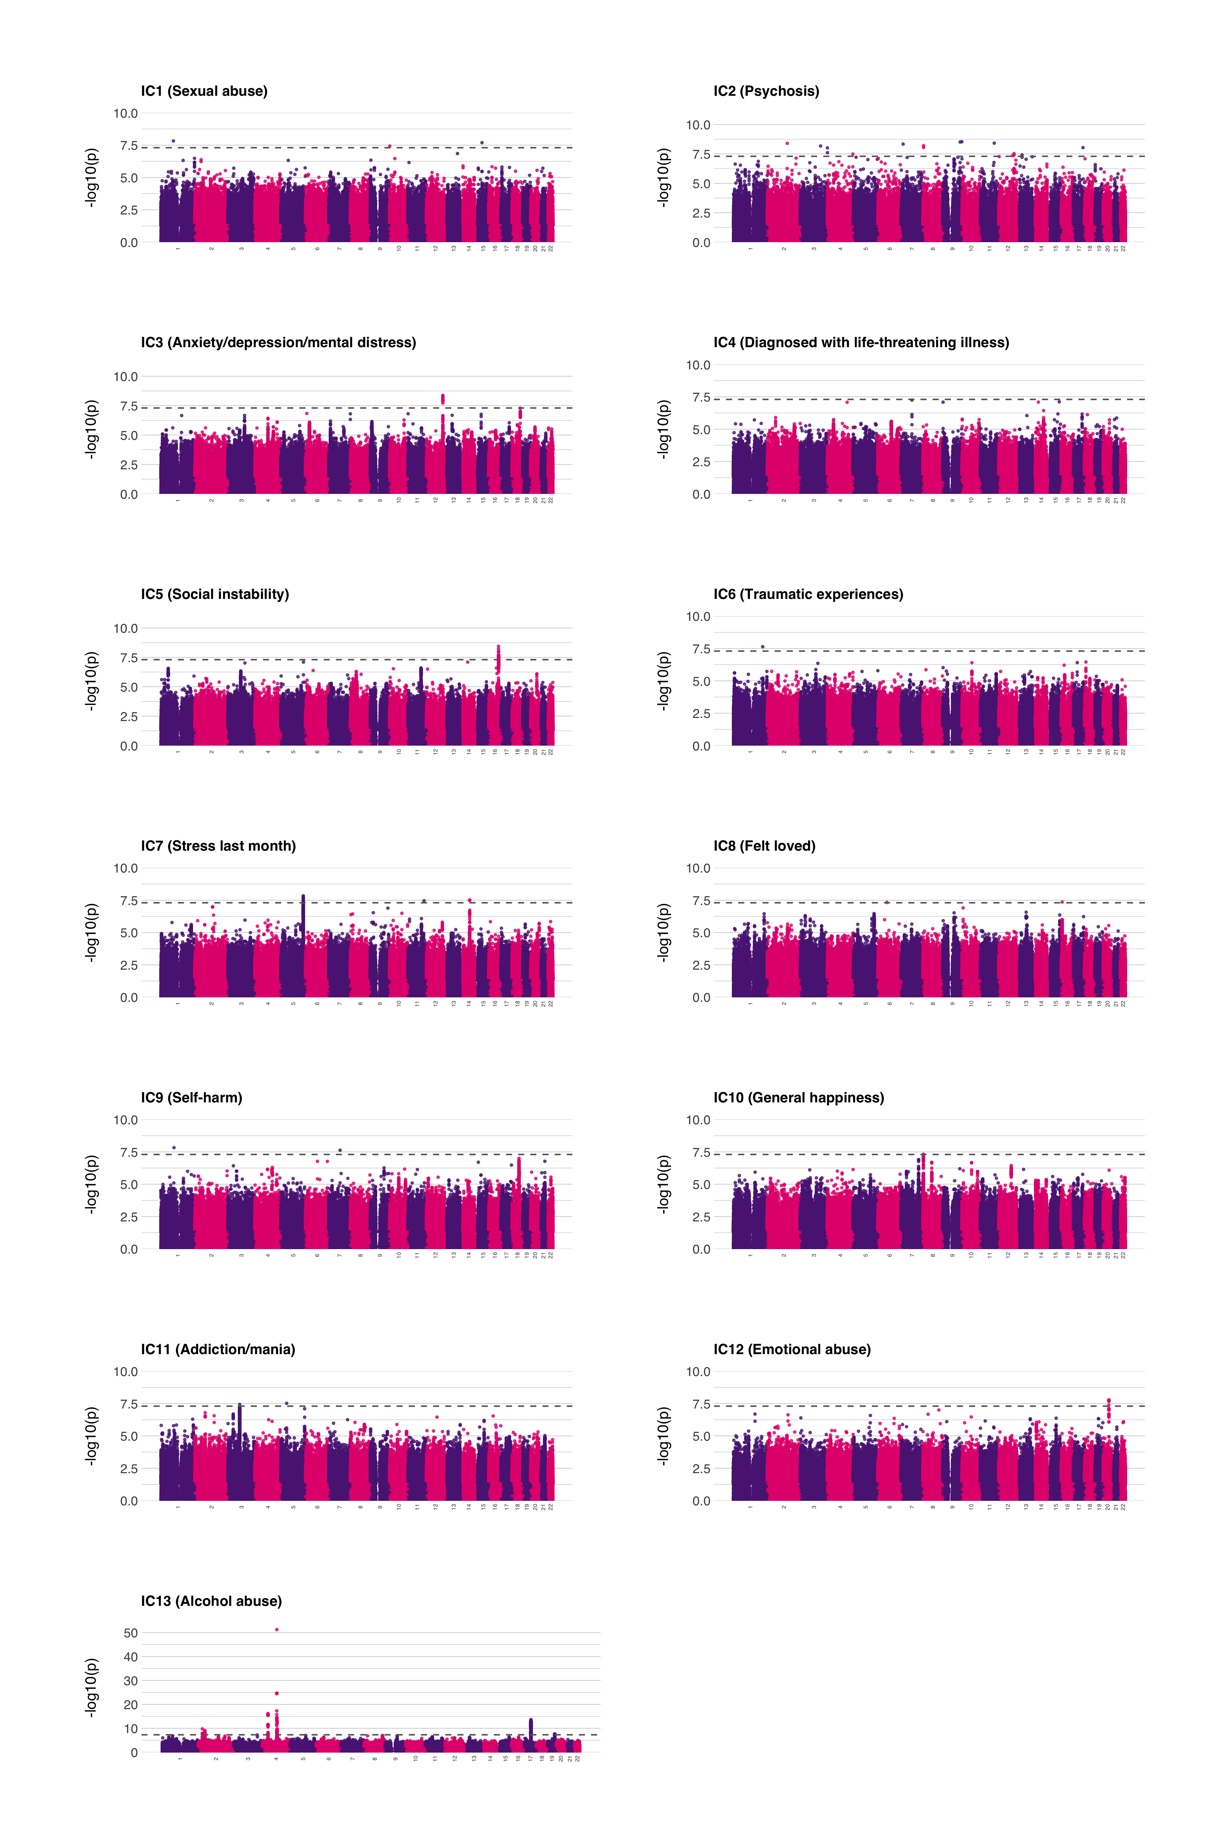

Slide 19
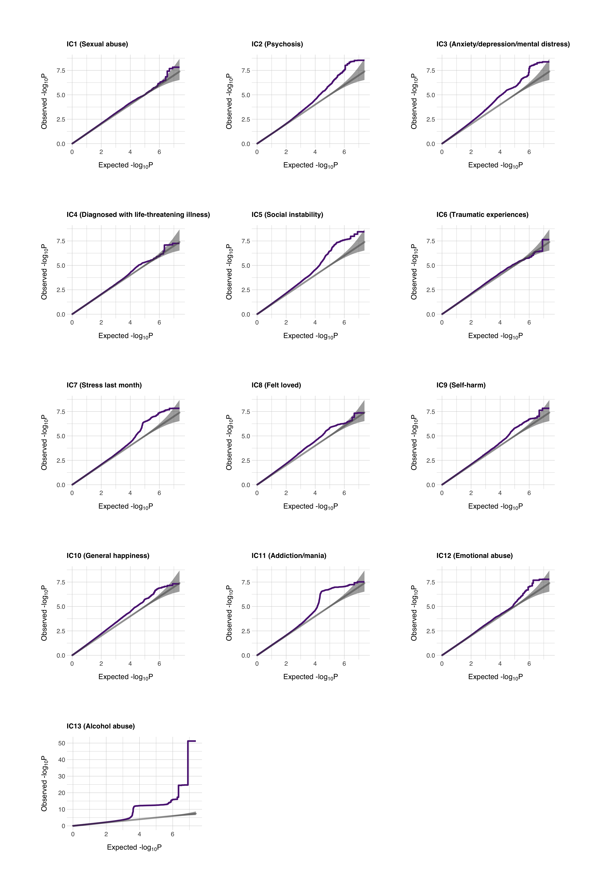

Slide 20
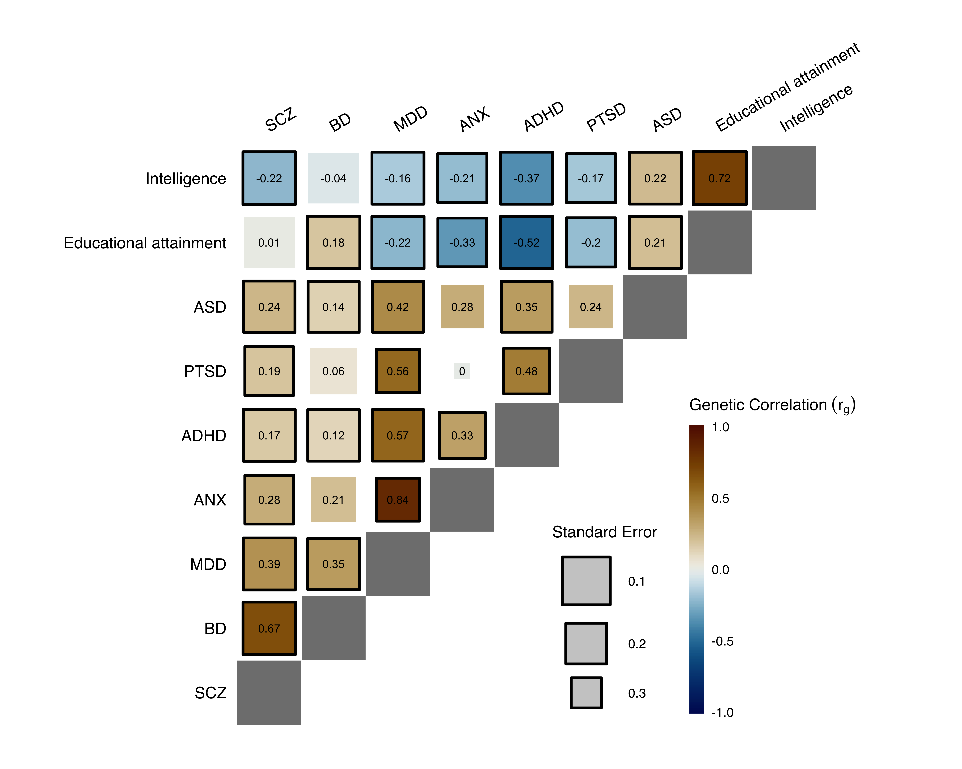

Slide 21
